Slide 1

DIMA eShop
Etion Pinari e Pietro Moroni

Slide 2
Purpose of the Application
User-friendly interface which connects clients and the vendors allowing them to respectively buy and sell products.
It works as an intuitive interface for clients to browse and buy products from our shop.
Both purchase and keep track of products you like by saving them as “favorites” for later.
The application is also designed to work for registered and unregistered users, providing most functionalities to both categories.

Slide 3
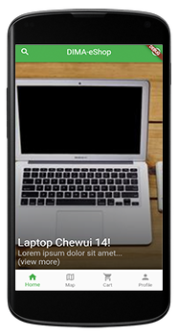
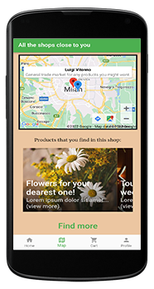
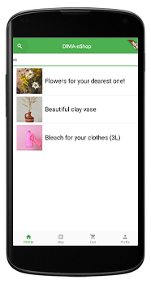
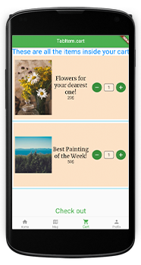
Interface Design

Slide 4

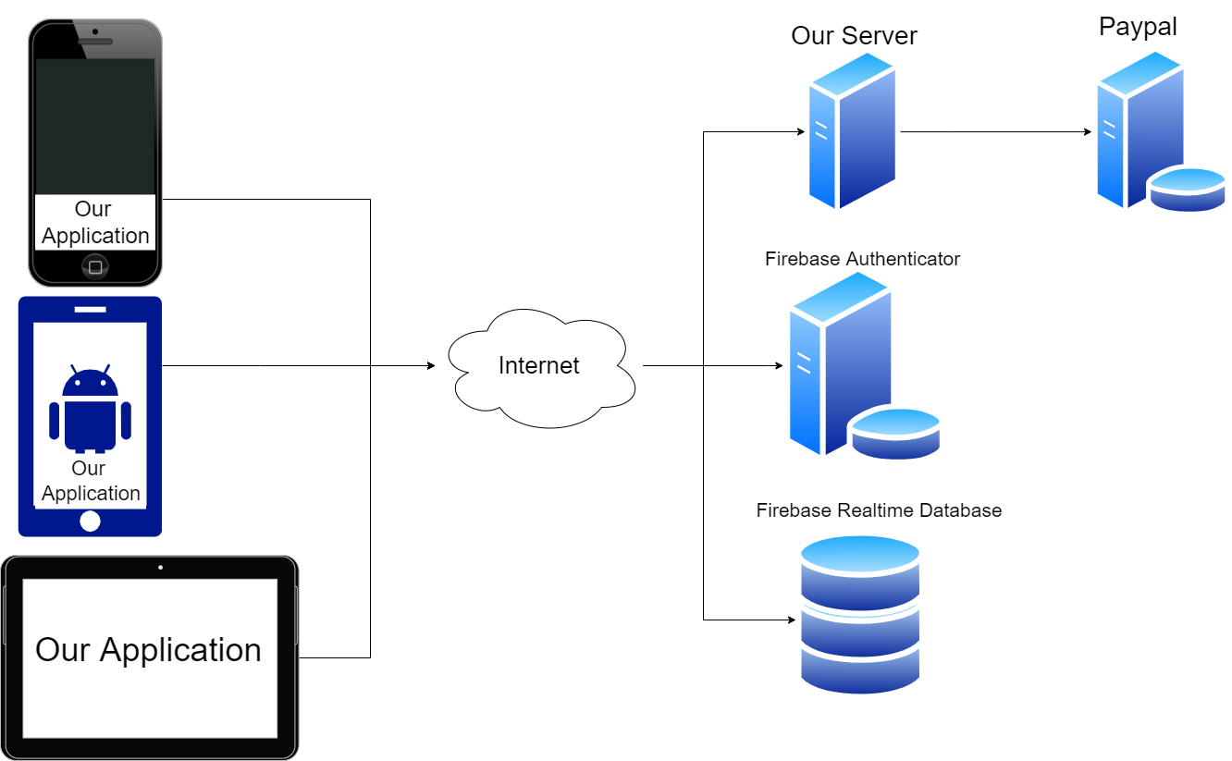



System Architecture
Cross platform mobile application
Using the flutter dart framework
Cloud backend

Slide 5
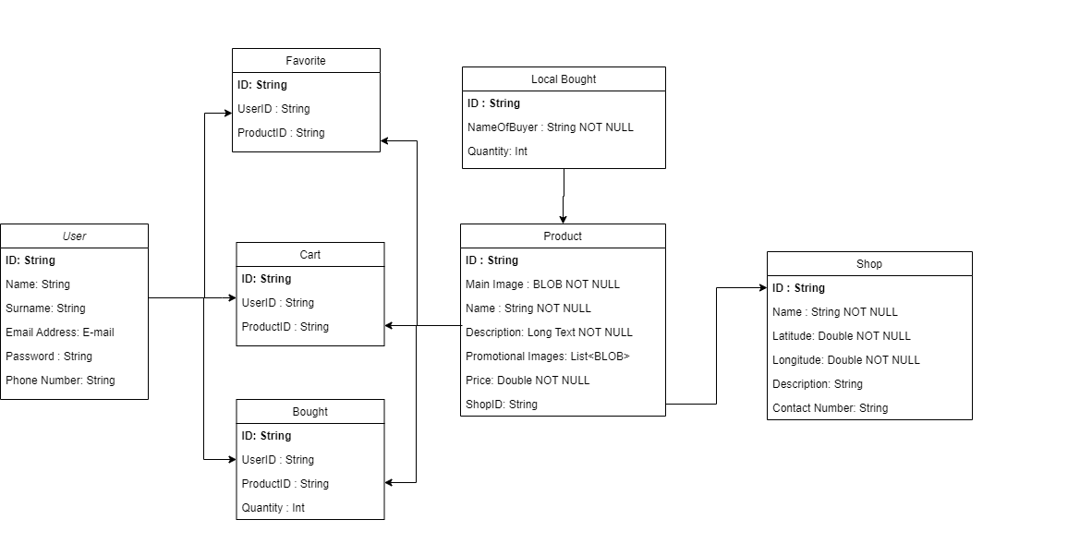
Database Design
We identified the three main entities
Users
Products
Shops
We use a special entity to keep track of unauthenticated users’ orders in the database

Slide 6




External Services and APIs
Firebase Authentication
Sign up
Sign in
Firebase Realtime Database
Shop and product data
User data
Google Maps Services
Nearest shops
Payment API
Flutter packages from pub.dev

Slide 7
Application Use Cases
Browsing the catalogue
Scrolling through the home page
Searching the catalogue through the search bar
Purchasing a product
Adding products to the cart
Modifying the cart’s content
Checking out
Looking up the nearest shops in the map

Slide 8
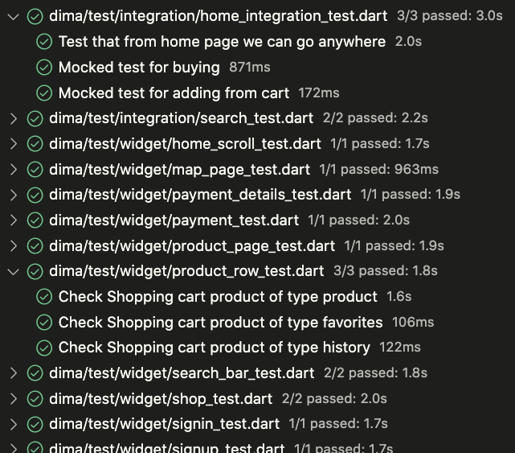
Testing Campaign
Widget Tests
Integration Tests
Tests are mocked with hard-coded data to avoid the logic being strictly dependent on the external services

Slide 9
Widget Tests
We designed tests for widgets that are then used inside larger-scope pages of the application
Widgets are tested by drawing them with mock data and asserting that each of their sub-components is rendered correctly and displays the correct information

Slide 10
Integration Tests
Integration tests are designed around an expected flow of actions that simulates an expected interaction of a user with the real application.
The interactions are also designed around the mock data since we decided to decouple database communication from the simulation.

